Slide 1
Chapter 12
Problem Solving & Creativity

Slide 2
What Is a Problem?
  An obstacle between a present state and a goal
  Not immediately obvious how to get around the obstacle
  Difficult to solve

Slide 3
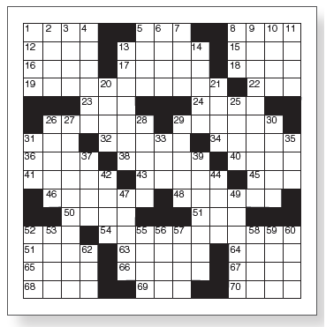
The Gestalt Approach (1 of 2)
  Representing a problem in the mind
  Restructuring: changes the problem’s representation
    Kohler’s “circle” problem

Slide 4
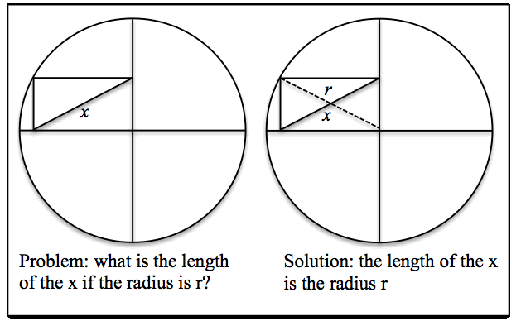
The Gestalt Approach (2 of 2)
Notes:
The key to solving this problem is to create the mental representation of x as being a diagonal (a straight line joining two opposite corners) of the small rectangle. Representing x as the diagonal enables us to reorganize the representation by creating the rectangle’s other diagonal.
Once we realize that this diagonal is the radius of the circle, and that both diagonals are the same length, we can conclude that the length of x equals the length of the radius, r.
What is important about this solution is that it doesn’t require mathematical equations. Instead, the solution is obtained by first perceiving the object and then representing it in a different way. The Gestalt psychologists called the process of changing the problem’s representation restructuring.

Slide 5
Insight in Problem Solving (1 of 5)
  A sudden realization of a problem’s solution
  Often requires restructuring the problem

Slide 6
Insight in Problem Solving (2 of 5)
  Metcalfe and Wiebe (1987)
    Insight: triangle problem, chain problem
    Noninsight: algebra
    Warmth judgments every 15 seconds

Slide 7
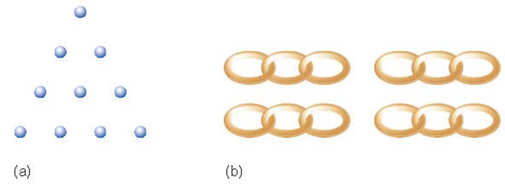
Insight in Problem Solving (3 of 5)
Notes:
Figure 12.4 (a) Triangle problem and (b) chain problem for “Two Insight Problems” demonstration. See page 389 for solutions.

Slide 8
Insight in Problem Solving (4 of 5)
  Metcalfe and Wiebe (1987)
    Insight problems solved suddenly
    Noninsight problems solved gradually

Slide 9
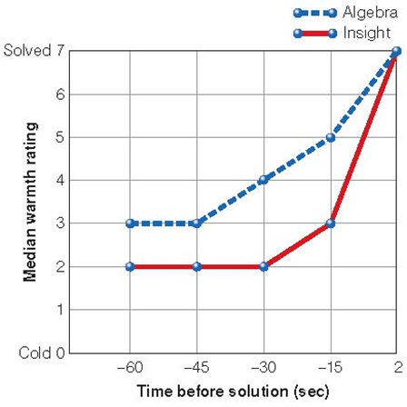
Insight in Problem Solving (5 of 5)
Notes:
Figure 12.5 Results of Metcalfe and Wiebe’s (1987) experiment showing participants’ judgments of how close they were to solving insight problems and algebra problems during the minute just before solving the problem.

Slide 10

Obstacles to Problem Solving (1 of 5)

Slide 11
Obstacles to Problem Solving (2 of 5)
  Functional fixedness: restricting use of an object to its familiar functions
    Candle problem: seeing boxes as containers inhibited using them as supports
    Two-string problem: function of pliers gets in the way of seeing them as a weight
Notes:
(Source: Based on K. Duncker, 1945)

Slide 12
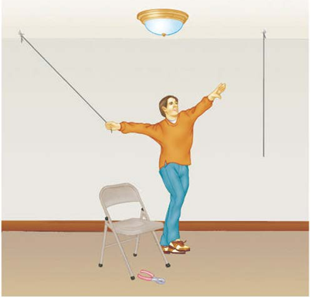
Obstacles to Problem Solving (3 of 5)
https://www.youtube.com/watch?v=e1d33TJauC8
Notes:
Figure 12.9 Maier’s (1931) two-string problem. As hard as the participant tries, he can’t grab the second string.
How can he tie the two strings together? (Note: Just using the chair doesn’t work!)

Slide 13
Obstacles to Problem Solving (4 of 5)
  Mental set
    A preconceived notion about how to approach a problem
    Based on a person’s past experiences with the problem (or similar problems)
    Water jug problem: given mental set inhibited participants from using simpler solution

Slide 14
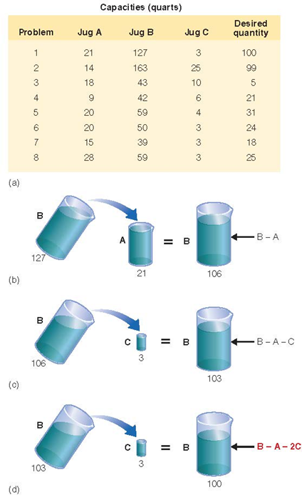
Obstacles to Problem Solving (5 of 5)
Notes:
Figure 12.10 (a) The Luchins (1942) water jug problem. Each problem specifies the capacities of jugs A, B, and C and a final desired quantity. The task is to figure out how to use the jugs with these capacities to measure out the desired quantity. (b) The first step in solving Problem 1; (c) the second step; (d) the third step. All of the other problems can be solved using the same pattern of pourings, indicated by the equation Desired quantity= B−A − 2C, but there are more efficient ways to solve Problems 7 and 8.

Slide 15
The Information-Processing Approach
  Newell and Simon
  Problem space
    Initial state
    Intermediate state(s)
    Goal state

Slide 16
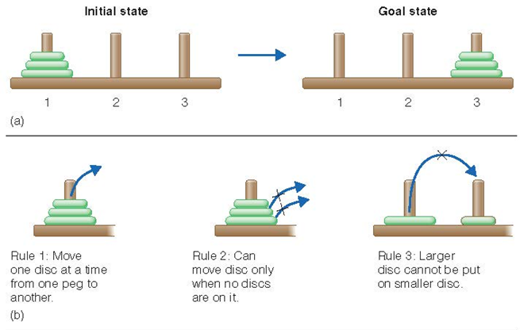
Information-Processing Approach (1 of 3)
  Tower of Hanoi problem
  Operators: rules specify which moves are allowed and which are not

Slide 17
Information-Processing Approach (2 of 3)
  Means–end analysis: reduce differences between initial and goal states
    Subgoals: create intermediate states closer to goal

Slide 18
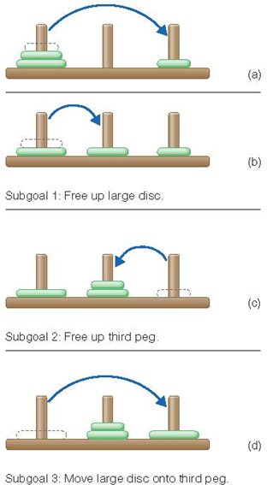
Information-Processing Approach (3 of 3)
Figure 12.13 Initial steps in solving the Tower of Hanoi problem, showing how the problem can be broken down into subgoals.
Notes:
(Source: Based on K. Kotovsky, J. R. Hayes, & H. A. Simon, 1985)

Slide 19
The Importance of How a Problem Is Stated (1 of 3)
  Mutilated checkerboard problem
    Conditions differed in how much information provided about the squares
    Easier to solve when information is provided that points toward the correct representation of the problem

Slide 20
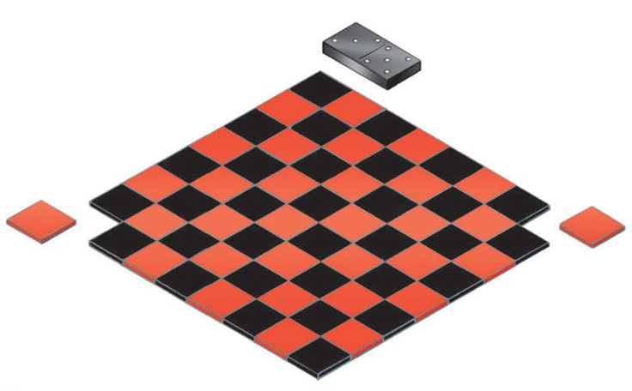
The Importance of How a Problem Is Stated (2 of 3)

Slide 21
The Importance of How a Problem Is Stated (3 of 3)
  Think-aloud protocol
    Say aloud what one is thinking
    Shift in how one perceives elements of a problem

Slide 22
Using Analogies to Solve Problems (1 of 6)
  Using a solution to a similar problem guides solution to new problem
    The Russian marriage problem (source problem) → mutilated checkerboard problem (target problem)
    “Analogical problem solving”
    Analogical transfer: The transfer from one problem to another
      Source problem to target problem

Slide 23
Using Analogies to Solve Problems (2 of 6)
  Gick and Holyoak
    Noticing relationship
    Mapping correspondence between source and target
    Applying mapping

Slide 24
Using Analogies to Solve Problems (3 of 6)
  Duncker’s radiation problem
    Analogies aid problem solving
    Often hints must be given to notice connection
      Surface features get in the way
      Structural features must be used

Slide 25
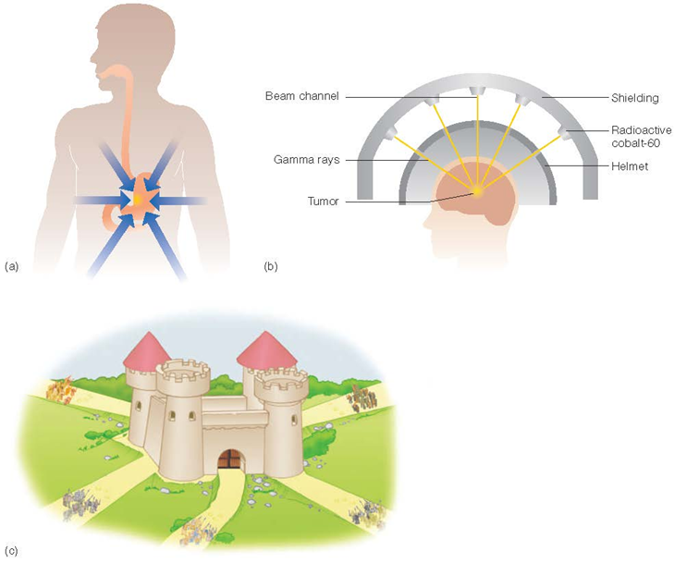
Using Analogies to Solve Problems (4 of 6)
Notes:
In this problem, a doctor has a patient with a malignant tumour. The patient cannot be operated upon, but the doctor can use a particular type of ray to destroy the tumour. However, the ray will also destroy healthy tissue. At a lower intensity the rays would not damage the healthy tissue but would also not destroy the tumour. What can be done to destroy the tumour?
A small country was ruled from a strong fortress by a dictator. The fortress was situated in the middle of the country, surrounded by farms and villages. Many roads led to the fortress through the countryside. A rebel general vowed to capture the fortress. The general knew that an attack by his entire army would capture the fortress. He gathered his army at the head of one of the roads, ready to launch a full-scale direct attack. However, the general then learned that the dictator had planted mines on each of the roads. The mines were set so that small bodies of men could pass over them safely, since the dictator needed to move his troops and workers to and from the fortress. However, any large force would detonate the mines. Not only would this blow up the road, but it would also destroy many neighbouring villages. Idevised a simple plan. He divided his army into small groups and dispatched each group to the head of a different road. When all was ready he gave the signal and each group marched down a different road. Each group continued down its road to the fortress so that the entire army arrived together at the fortress at the same time. In this way, the general captured the t therefore seemed impossible to capture the fortress. However, the general fortress and overthrew the dictator.

Slide 26
Using Analogies to Solve Problems (5 of 6)
  Analogical encoding: process by which two problems are compared and similarities between them are determined
  Negotiation strategies
    Trade-off strategy: “I’ll give you A if you give me B.”
    Contingency strategy: Person gets what they want if something else happens

Slide 27
Using Analogies to Solve Problems (6 of 6)
  Analogical paradox
    It can be difficult to apply analogies in the laboratory, but people routinely use analogies in real-world setting

Slide 28
Using Analogies to Solve a Problem
  In vivo problem-solving research
    People are observed to determine how they solve problems in the real world
      Advantage: naturalistic setting
      Disadvantages: time-consuming, cannot isolate and control variables

Slide 29
How Experts Solve Problems (1 of 3)
  What is an expert?
    “A person who, by devoting a large amount of time to learning about a field and practicing and applying that learning, have become acknowledged as being extremely knowledgeable or skilled in that field.”
  Experts solve problems in their field more quickly and with a higher success rate than beginners
  Experts possess more knowledge about their fields

Slide 30
How Experts Solve Problems (2 of 3)
  Knowledge is organized so it can be accessed when needed to work on a problem
    Novice: surface features
    Expert: structural features

Slide 31
How Experts Solve Problems (3 of 3)
  Experts spend more time analyzing problem
  Experts are no better than novices when given problems outside of their field
  Experts less likely to be open to new ways of looking at problems

Slide 32
Creative Problem Solving (1 of 3)
  Creativity
    Innovative thinking
    Novel ideas
    New connections between existing ideas
    Divergent thinking: open-ended; large number of potential “solutions”

Slide 33
Creative Problem Solving (2 of 3)
  Creative cognition: technique to train people to think creatively
    Preinventive forms: ideas that precede creation of finished creative product

Slide 34
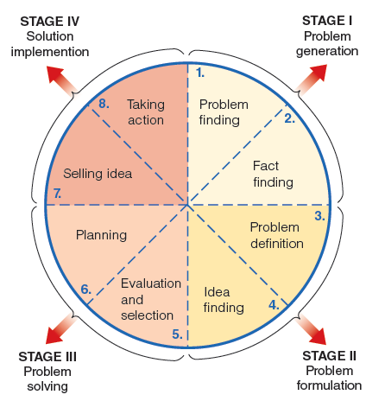
Creative Problem Solving (3 of 3)
Notes:
Figure 12.22 Problem solving process proposed by Basadur et al. (2000). Basadur proposes four steps, each of which is divided into two processes. For example, Stage II, problem formulation, consists of two steps: defining the problem and finding ideas.

Slide 35
Creativity and the Brain (1 of 3)
  Chi and Snyder (2012)
    Deactivated left anterior temporal lobe causing people to think “outside the box” in nine-dot problem
  Kounios et al. (2006): “The Prepared Mind”
    Used EEG on compound remote-associate problem
    Frontal lobe activity increased before insight solutions
    Occipital lobe activity increased before noninsight solutions

Slide 36
Creativity and the Brain (2 of 3)
  Default mode network
    Incubation: getting ideas after taking “time out” from working on a problem
  Mayseless et al. (2015):
    Participants suggest alternate uses for an object
    Higher originality ratings associated with higher activity of structures in default mode network

Slide 37
Creativity and the Brain (3 of 3)
  Ellamil et al. (2012)
    Regions of default mode network (DMN) and executive control network (ECN) more strongly activated during idea evaluation than idea generation
    Normally DMN and ECN work in opposition
      Creative thinking is different.

Slide 38
Things Creative People Do Differently
  Daydreaming
    Volitional daydreaming: purposeful mind wandering
  Solitude
    Avoiding distractions; giving the mind space and time to make new connections and find meaning
  Mindfulness
    Focused attention meditation: focus on one thing, such as the breath, and return to it when distracted
    Open monitoring meditation: pay attention to whatever comes up and follow it until the next thing

